Slide 1





The City of New York
Mayor’s Office of Media and Entertainment
PRESS CREDENTIALS OFFICE (PCO)
Samer Nasser, Executive Director
Eileen Yap, Special Counsel
Visit us at nyc.gov/presscredentials
Commissioner Anne del Castillo

Slide 2

01. About
02. Press Card
Quick Links
Available for Download:
  A Guide to Your Trial at the OATH Trials Division​
  The Press Credentials Office Presentation
  How to Register for an Account
  How to Apply for a Press Card
03. Application Portal
04. Cardholder Rights
05. Renewal Process

Slide 3


The Press Credentials Office
NYC.GOV/PRESSCREDENTIALS
03
The rules provide members of the press the opportunity to appear before an independent court, the Office of Administrative Trials and Hearings (OATH) when they want to appeal or challenge an application denial.
The PCO also cannot suspend or revoke a press card without a hearing and a decision from OATH.
The PCO is now the only city agency authorized to issue, deny, suspend or revoke a City of New York Press Card.
Pursuant to Local Law 46 of 2021, which transferred the responsibility to issue press credentials or “Press Cards” from the New York City Police Department (NYPD) to the Mayor’s Office of Media and Entertainment (MOME), MOME set forth rules (Title 43, Chapter 16 of the Rules of the City of New York.) for press card application procedures, criteria for denial of an application, and criteria for suspension or revocation of a press credential.
Sample Text
Subtitle if needed

Slide 4

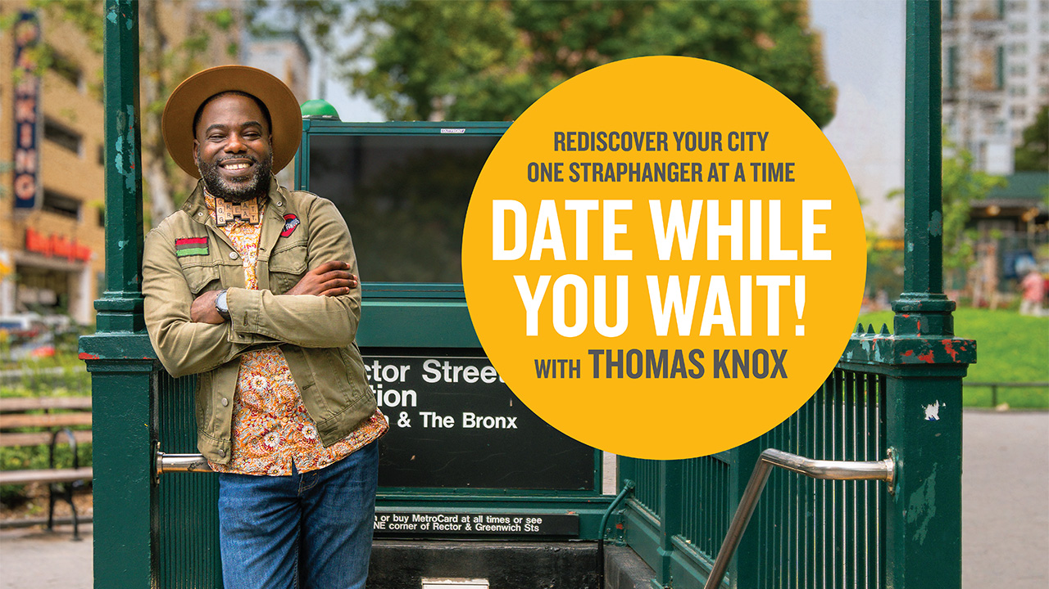

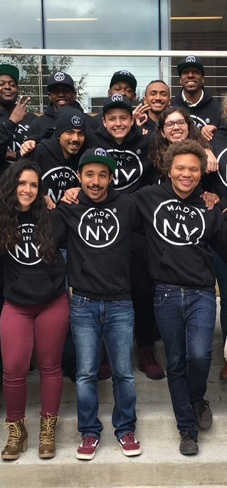
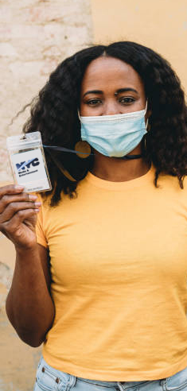




PCO Mission
In alignment with MOME's mission of supporting and strengthening New York City’s creative economy and making it accessible to all, The PCO aims to provide members of the Press with a timely, transparent, and equitable Press Card application process by establishing seamless operational policies, providing the opportunity for a hearing and appeal process, and guiding members of the press on how to qualify for and obtain a City of New York Press Card.
NYC.GOV/PRESSCREDENTIALS
Office of Film, Theatre & Broadcasting
The one-stop shop for all production needs in NYC.
NYC Media
The official television, radio and online network of the City of New York.
Office of Nightlife
Established in 2017 to support New York City’s nightlife industry, which includes restaurants, nightclubs and music venues.
Programs & Initiatives
Programs, initiatives, and resources for all New Yorkers – from those who work in the creative industries and those who aspire to a career in these industries, to those who simply want to experience the city's cultural offerings.
Press Credentials Office
Issues press cards for news gathering organizations.

Slide 5
The City of New York Press Card
NYC.GOV/PRESSCREDENTIALS
Press Card Privileges
A Press Card is not required to engage in newsgathering activity and work as a journalist in New York City.
A Press Card is required for the following “Covered Events.” Subject to space limitations, safety concerns, and evidence preservation concerns, a press card entitles a member of the press to:
  Cross police and fire lines, or other restrictions, limitations, or barriers established by the City of New York at emergency, spot, or breaking news events and non-emergency public events
  Attend City-sponsored events that are open to members of the press.
Press Cards are valid for up to two years and expire on January 15th of every odd year.
Press Card Guidelines
NYPD-issued Press Cards are valid until Jan. 15, 2023.
Press Card holders with an expired NYPD-issued Press Card must renew their press credentials with the PCO.

Slide 6

Press Card
NYC.GOV/PRESSCREDENTIALS
Press Card Guidelines continued
There is no fee required for a Press Card
A Press Card must be worn fully exposed at all times while newsgathering
NYPD can no longer seize valid City of New York Press Cards
The PCO only issues Press Cards
The PCO does not schedule interviews with the Mayor, issue parking permits, or handle Mayoral event calendars
For more information about other NYC services, please visit https://www1.nyc.gov
Press Card Required Information
Personal Information
Company Information, if applicable
Six or more qualifying media file submissions
A valid government issued ID
Applications for a Standard Press Card and Single Event Pre-Registration also require certain criminal history information
All information on applications must be submitted in English
Media Files in a Language other than English are acceptable
Language Services: MOME provides language access services in multiple languages and includes free interpretation and translation services.

Slide 7
Press Card
NYC.GOV/PRESSCREDENTIALS
Three Types of Press Card
Standard Press Card | Reserve Press Card | Single Event Press Card
Issued to independent newsgathers, freelancers, and full-time employees of newsgathering organizations | Issued to newsgathering organizations applying on behalf of their employees who do not hold a Standard Press Card | Issued to independents and freelancers and full-time employees of a newsgathering organization who do not hold a Standard or Reserve Press Card
Include the journalist’s name and photo, employment status and the expiration date of the Press Card Provides Press Card privileges to multiple news events while the Press Card is valid | For use by the Newsgathering Organization’s employees to cover multiple news events while the Press Card is valid Includes Newsgathering Organization’s name and expiration date | For access to one event in NYC that specifically requires a City of New York Press Card Includes journalist’s name, photo, the name of the Single Event, and the validity period of the Press Card

Slide 8
The Application Portal
NYC.GOV/PRESSCREDENTIALS
Apply for a Press Card
Renew A Press Card
Submit an Appeal
Check Your Application Status
Report Lost/Stolen Press Card

Slide 9

Eligibility Criteria
NYC.GOV/PRESSCREDENTIALS
Standard & Reserve Press Cards
Single Event Press Cards (2 step process)
√
Submit six published stories. Accepted types of media include: articles, commentaries, books, photographs, videos, films or audio (accepted file formats: pdf, jpeg, png, mp3 & mp4)
STEP 1: PRE-REGISTER TO COVER CITY SPONSORED EVENTS
√
Submit six or more media
√
Accepted Media: Articles, commentaries, books, photographs, videos, films, or audio
√
Must be a ‘Covered Event’
√
√
Accepted File Media: PDF, JPEG, PNG, MP3, and MP4
Media must be published, broadcast, or cablecast within the 24 months immediately preceding the application submission date
√
Media must be published, broadcast, or cablecast within the 24 months immediately preceding an application submission
√
√
The events must occur on separate days
The events must occur on separate days
√
√
The events must be covered in-person
The events must be covered in-person
√
√
Events must occur in one of the five boroughs of New York City
Events outside of NYC are eligible
STEP 2: APPLY FOR A SINGLE EVENT PRESS CARD FOR THE SPECIFIC EVENT YOU WANT TO COVER

Slide 10
Eligibility Criteria
Single Event Press Cards (continued)
NYC.GOV/PRESSCREDENTIALS
STEP 2: APPLY FOR A SINGLE EVENT PRESS CARD FOR THE SPECIFIC EVENT YOU WANT TO COVER

Slide 11

Press Cardholder Rights
NYC.GOV/PRESSCREDENTIALS
The Right to Due Process:
A Member of the Press has the right to appeal an application denial or challenge a press card suspension or revocation with an independent court, OATH.
Summary Seizure of City of New York Press Cards is now prohibited under the new rules.
No agency, including the NYPD, may seize a valid Press Card until OATH determines that the press card suspension or revocation is proper.
OATH hears three types of cases involving City of New York Press Cards:
Denial: A case brought by a press card applicant who believes the PCO wrongly denied a press card application. OATH will issue a written decision either granting or denying an appeal. If OATH grants your appeal, the PCO must promptly provide you with a press card. If OATH denies your appeal, the PCO’s decision stands.
Suspension: A case brought by the PCO when it seeks to temporarily suspend a press card.
Revocation: A case brought by the PCO when it seeks to revoke a press card for a longer period than a suspension.
Free OATH Language Services: Interpreters by phone or video call during the trial and document translation. For more details, please refer to the OATH guide. Press Credentials – A Guide to Your Trial at the OATH Trials Division
The 1960’s - Breakfast at Tiffany’s, Rosemary’s Baby
The 1970’s - The Godfather, The French Connection
The 1980’s - Scarface, Moonstruck, Do the Right Thing, Ghostbusters
The 1990’s - Carlito’s Way,The Usual Suspects, Requiem for a Dream
The 2000’s - Vanilla Sky, I Am Legend
2010 to present - Dark Knight Rises, John Wick

Slide 12


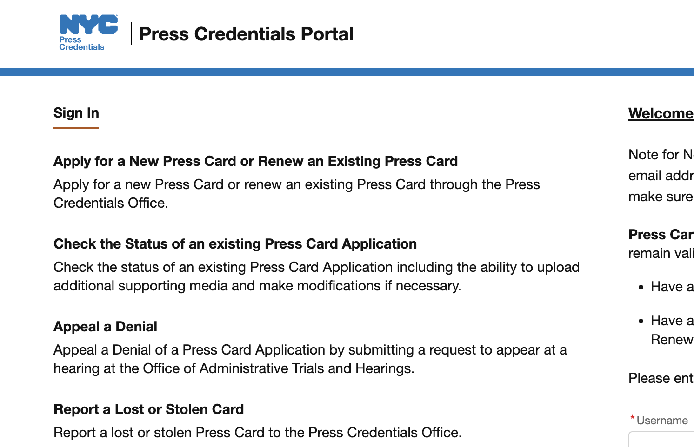
NYC.GOV/PRESSCREDENTIALS
Report Lost or Stolen Press Cards
Step One
Step Two
Step Three
Obtain an NYPD Report Verification of Crime/Lost Property Report
Notify your employer, if applicable
Submit a copy of the Verification of Crime/Lost Property Report to the Press Credentials Office via the online portal

Slide 13
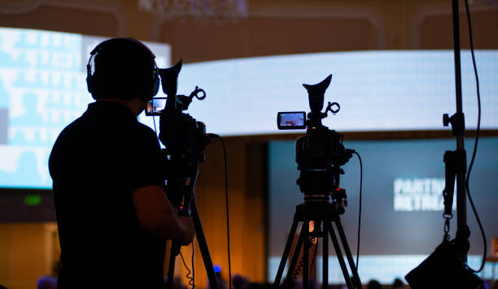
2023 Renewal Process
NYC.GOV/PRESSCREDENTIALS
The PCO is accepting renewal applications for press cards expiring on Jan. 15, 2023, through our online system beginning July 5th, 2022, based on the first letter of your last name. Please refer to the schedule below:
Press Card Type | When to Apply
Standard
A-C | July 5 – July 29
D-H | Aug 1 – Aug 26
I-L | Aug 29 – Sept 23
M-P | Sept 26 – Oct 21
Q-S | Oct 24 – Nov 18
T-Z | Nov 21 – Dec 15
Reserve
All | July 5 - Dec 15

Slide 14

The City of New York
Mayor’s Office of Media and Entertainment
Press Credentials Office (PCO)
1 Centre Street South, Room 370
Monday through Friday, from 9:00 a.m. to 5:00 p.m., excluding City holidays.
presscredential@media.nyc.gov
(212) 602-7408

